Slide 1
Math-Learning Platform
Designed and Implemented by: K. Carlson
Supervised by: Mr Ngatchu Damen

Slide 2
Objectives
Purpose
Front End and Functionality of the platform
Upcoming features
New stuff learned
Difficulties

Slide 3
Purpose:
To make learning easy and fun for kids of all ages.
To cultivate math solving capabilities in kids of all ages.

Slide 4
Implementation and Design
The platform is built completely in Javascript(pure) with a little bit of Jquery(to ease typing :-) )
The questions are randomly generated with the wrong answers also randomly generated.
For now the only operations allowed are +, -, /, *
With single and double digits involved.
Answers are provided in floating point.

Slide 5
Design
The front end is simplistic with layout showing only the question, the answers with the possibility of the user clicking one and only one.
The user can also see the number of questions attempted.
There is also the possibility of skipping a question by clicking the “skip question” button.
There is also the possibility of generating a new question at the cost of 2pts by clicking the “generate new question” button.
Clicking on the exit button shows your current score and your grade.
Below is a screenshot of the front end.

Slide 6
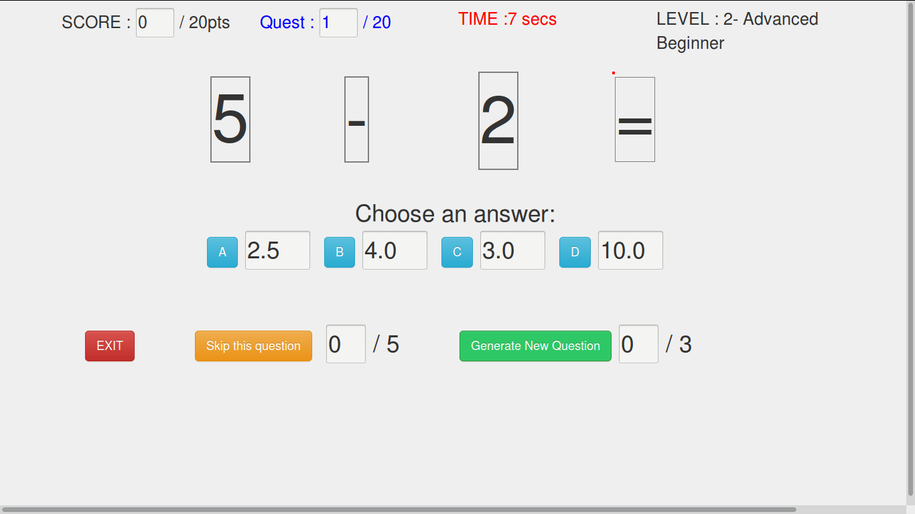
Front end

Slide 7
Functionality
Upon the page loading, the timer starts and the user can see the question with the answers provided.
Upon clicking the answer, the user is prompted to make sure of their answers.
They have the possibility of accepting or refusing and changing their mind

Slide 8
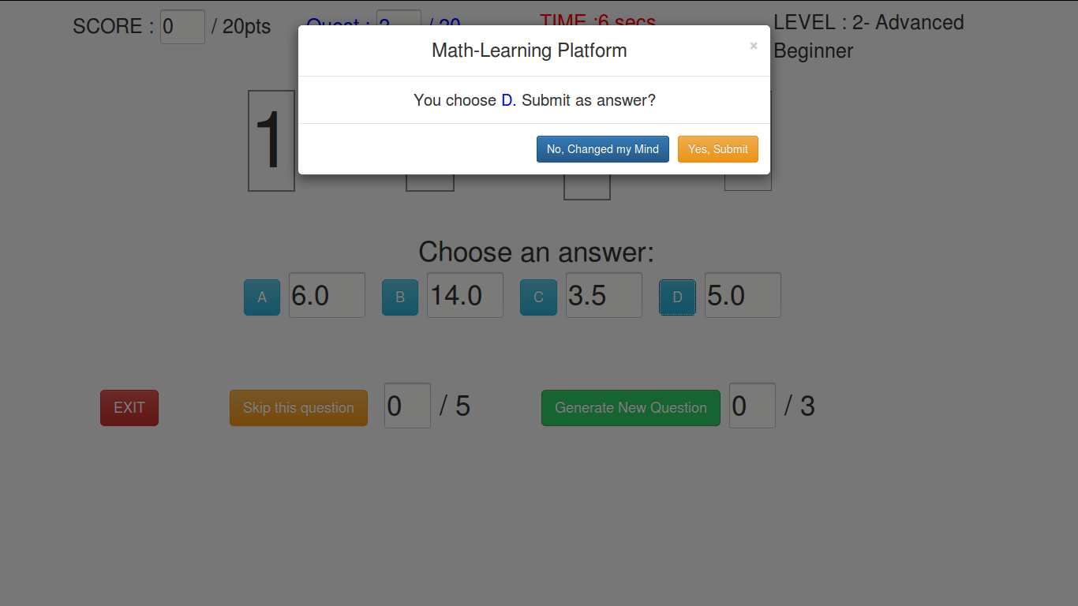
Functionality

Slide 9
Functionality(Cont'd)
When the user clicks on the generate they are given an opportunity to change their minds.
Same for the skip question button being clicked.
2points are subtracted each time the user generates a new question and for every question generated, that is plus one question answered.
A user can only generate at most 3 questions.
A user can only skip at most 5 questions.
The criteria for the above chosen numbers is based on instinct and can of course be changed.
No points a subtracted for skipping any question.

Slide 10
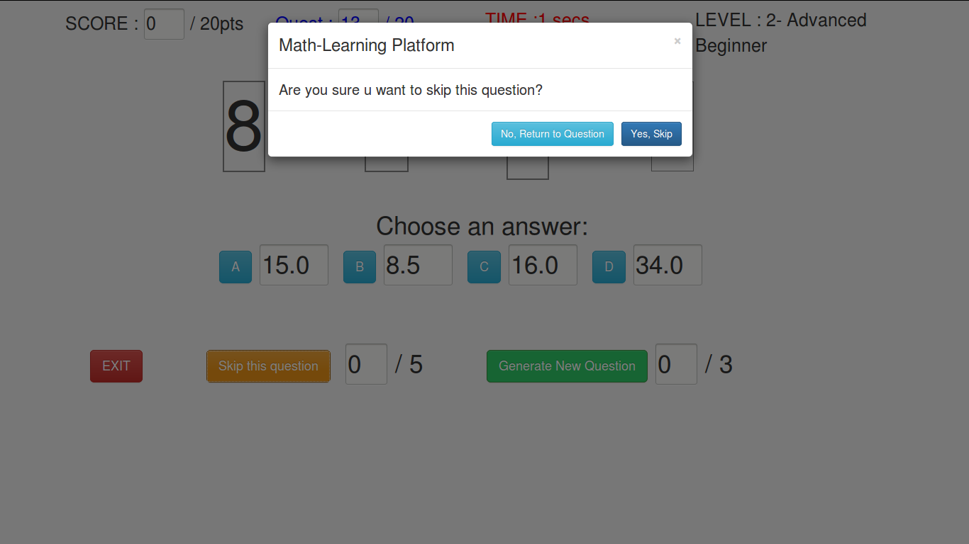
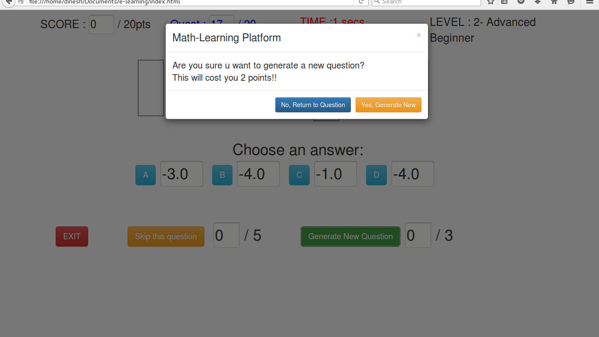
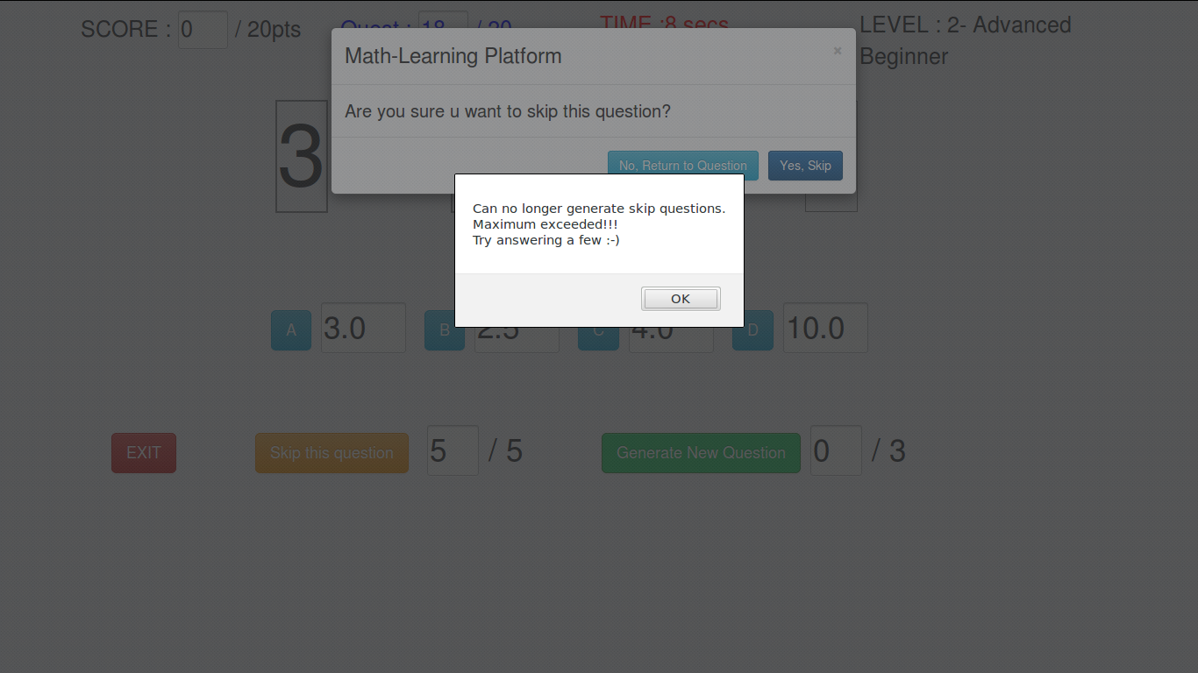
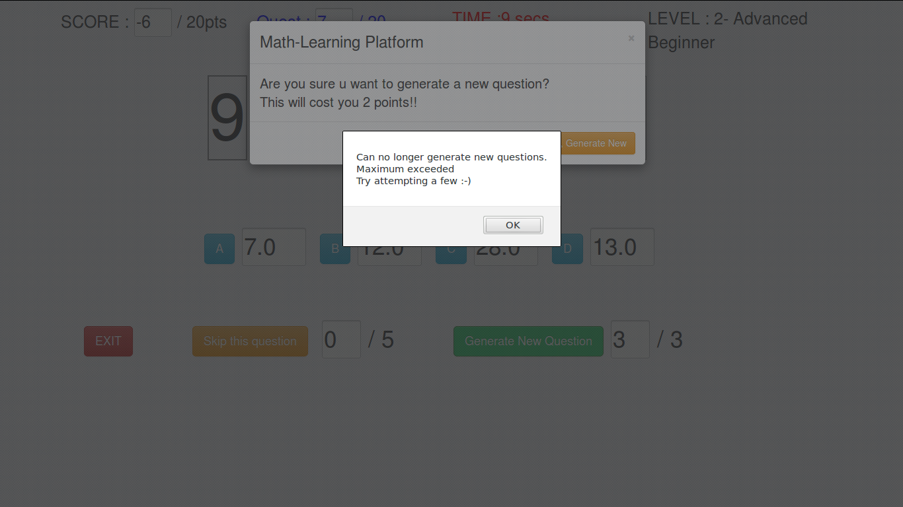
Functionality(Cont'd)

Slide 11
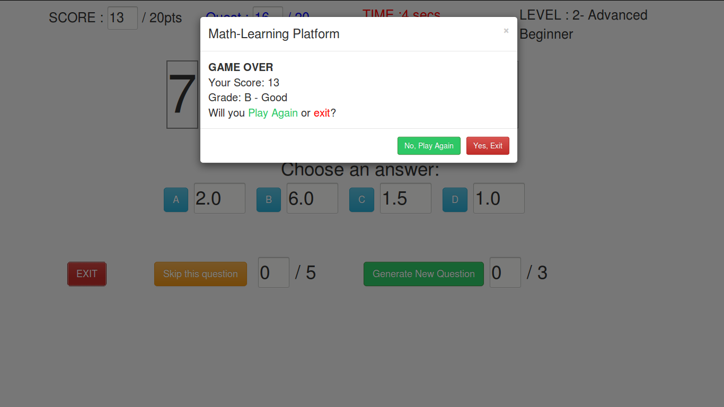
Rudimentary reporting System

Slide 12
Upcoming features
The system will have be a user based system. That is every user will have an account.
Every game is recorded so a user can view their history
Multi levels to cover kids, students and even parents where each level comes with well designed questions suited for that age group which are of course randomized.
Ability to pause the game.
Mad effects to keep users hooked and interested

Slide 13
Upcoming features(Advanced)
Badge awarding system
Ability to progress through the levels upon completion of previous levels e.g. from kid to student to parent or whatever that will be probably adult.
Report printing
Ability to move and use javascript file as an external API for any newly implemented or other front end interface
Version for all platforms(iOs, Android and others) and also for multiple devices(computers, tablets, phablet, and mobile devices).

Slide 14
New Stuff learned
Javascript experience
Dealing with pressure

Slide 15
Difficulties
Time availability
More to be added as time goes on. *
Thanks for you kind attention!!!!
        Questions and Demo Time!!!!!

